Slide 1
Python
Control Flow 2
in programming

Slide 2
Loops in python
Loops
In python or in any other programming language as they help you to execute a block of code repeatedly.
Loops can be of 2 types in Python
Why
To write less code, concise code for repeated process
When
for
while
Run a code block repeatedly
Process item in a sequence with same code

Slide 3
For loop concept
for
there isn't any condition actively involved - you just execute a piece of code repeatedly for a number of times.
init
loop
Fact
the "for" keyword in "for loop" refers to something that you do for a certain number of times.
Check for data
If there is no data
Get an item from sequence
stop
If there is data
It executes a piece of code over and over again "for" a certain number of times, based on a sequence.
Execute code

Slide 4

For loop
for
x =
P
Y
T
H
O
N
loop
init
How many characters we have
Get an item from sequence
If there is no data
stop
This is a sequence
Check for data
If there is data
Because x contain multiple items so it can be taken as sequence.
Execute code

Slide 5
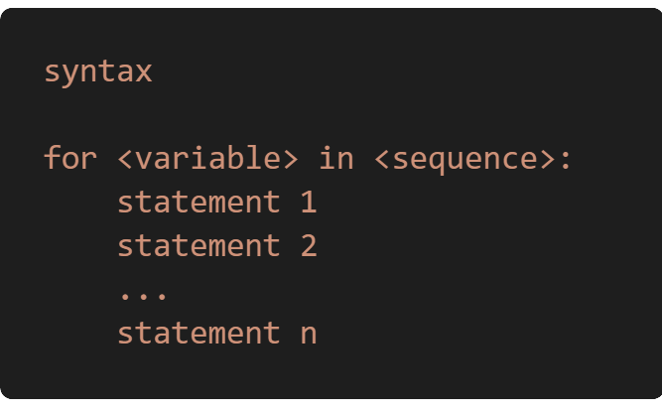
For loop
for
x =
loop
P
Y
T
H
O
N
for loop syntax
How many characters we have
This is a sequence
Because x contain multiple items so it can be taken as sequence.

Slide 6
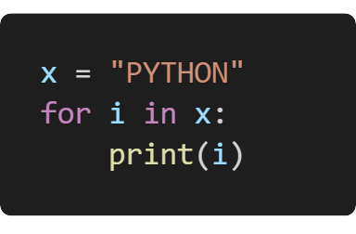

For loop
for
loop
for loop syntax

Slide 7
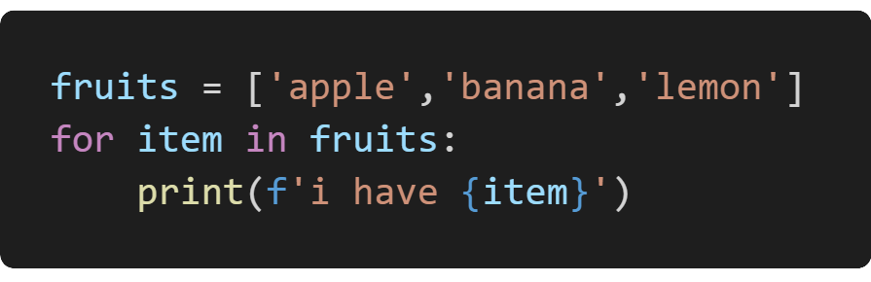

For loop
for
loop
for loop syntax
output

Slide 8
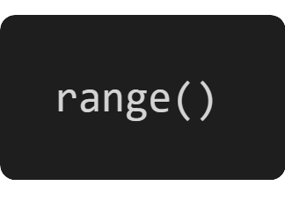
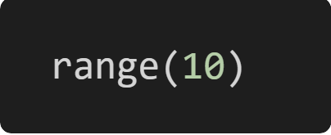
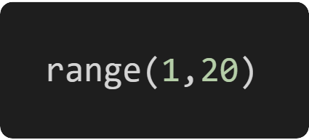
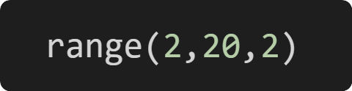
range() function
for
We can use the python’s range() function to specify how many time a loop will run
loop
Depending on how many arguments we is passing to the function, we can decide where that series of numbers will begin and end as well as he gap between one number and the next.
The range will be 10 item , from 0 to 9. 10 is the stopping value
The range will be from 1 to 19, 20 is the stopping value
range() takes mainly three arguments
(optional) start: integer, which tells us the start value of the loop
stop: integer, that marks the end value of the range, for which the loop will run. It should be always n+1, where n is stop value
The range will be from 2 to 18, and the gap between each number is 2, and 20 is stopping value
(optional) step: the gap between to 2 consecutive numbers in a range

Slide 9
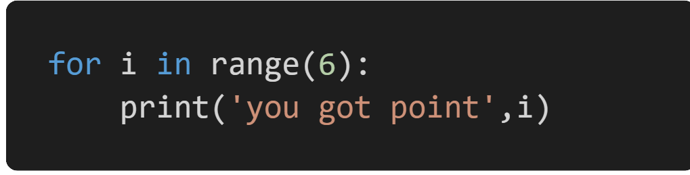
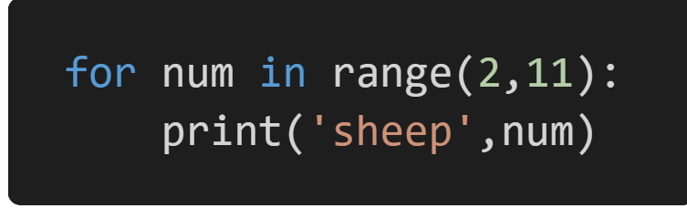
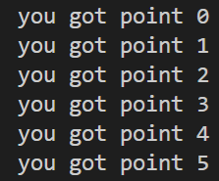
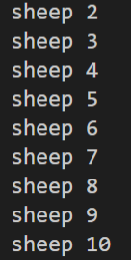
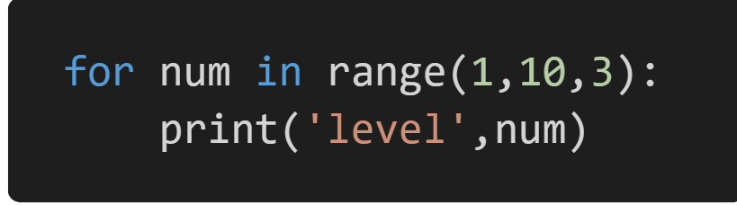

range() function
for
loop
examples

Slide 10
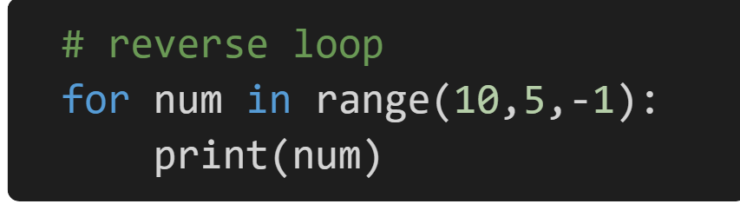
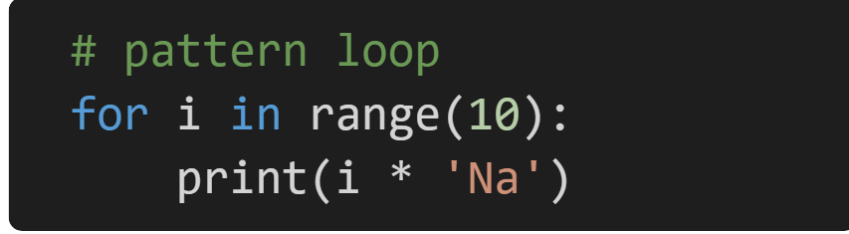

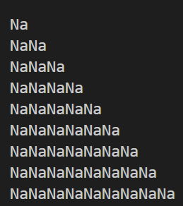
range() function
for
loop
examples

Slide 11
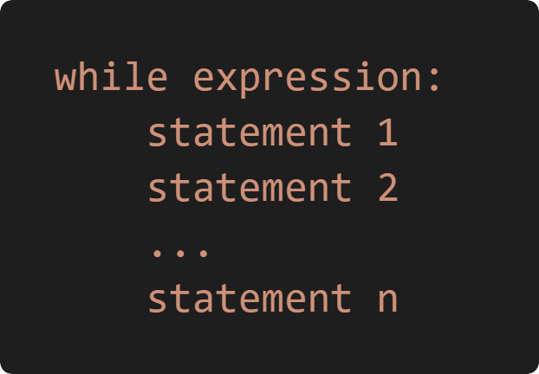
While loop
while
loop
Syntax of while Loop in Python
The while loop in Python is used to iterate over a block of code as long as the test expression (condition) is True.
We generally use this loop when we don't know the number of times to iterate beforehand.

Slide 12
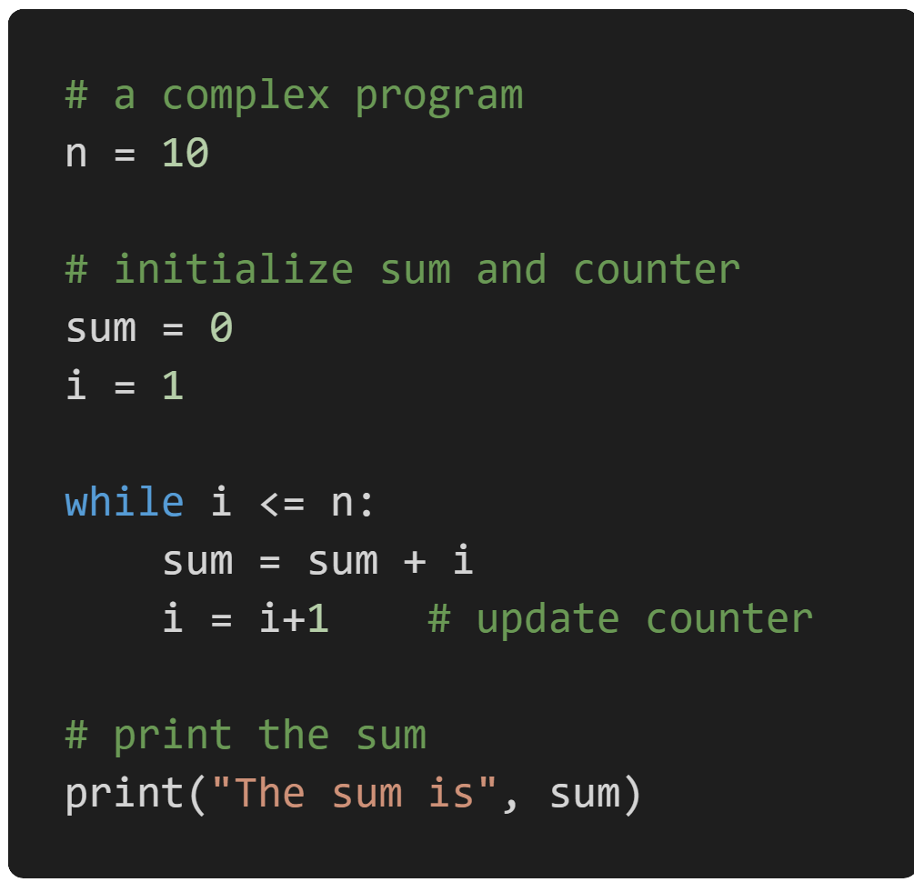
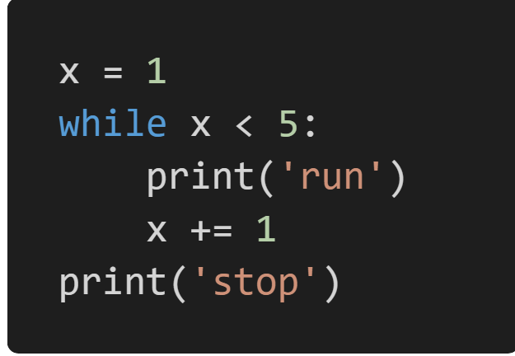
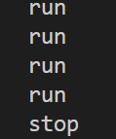
While loop
while
loop

Slide 13
Break and Continue
In Python, break and continue statements can alter the flow of a normal loop.
Break representation
Loop starts
Get item from sequence
False
True
Loops iterate over a block of code until the test expression is false, but sometimes we wish to terminate the current iteration or even the whole loop without checking test expression.
break ?
Yes
No
The break and continue statements are used in these cases
STOP
CODE inside Loop

Slide 14
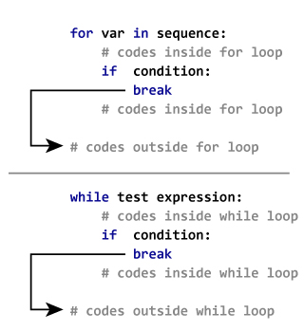
Break and Continue
Break representation
Loop starts
Get item from sequence
False
True
break ?
Yes
No
STOP
CODE inside Loop

Slide 15
Break and Continue
continue representation
Loop starts
Get item from sequence
False
The continue statement is used to skip the rest of the code inside a loop for the current iteration only.
True
continue ?
Yes
Loop does not terminate but continues on with the next iteration
No
STOP
CODE inside Loop

Slide 16
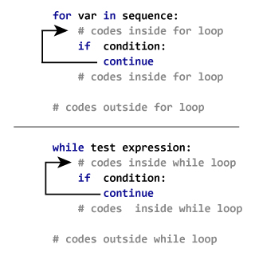
Break and Continue
continue representation
Loop starts
Get item from sequence
False
True
continue ?
Yes
No
STOP
CODE inside Loop

Slide 17


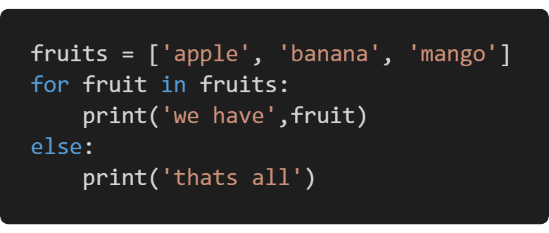
Special loop
For else
loop
for loops can also have an optional else clause.
The common use is to loop and search for an item. If the item is found, we break out of the loop using the break statement
The else clause executes after the loop completes normally
This means that the loop did not encounter a break statement

Slide 18
Create this pattern
1 2 3 4 5
2 4 6 8 10
3 6 9 12 15
4 8 12 16 20
5 10 15 20 25
Activity

Slide 19
THE END

